Slide 1

Module 8 – Change and Release Management
Jan 2018
Notes:
[STANDARD SLIDE: L300 (animated)]
You can change out the photo with any image from Getty Images in DropBox.
If the main title is shorter, you can make the font larger.
You may have to move the title text around depending on the photo. Make sure the text is readable against the background photo.
You can change the background color for the rectangle in the bottom-right corner to look better against the background. Choose a Micro Focus color at 25% transparency.
=========================
Note to Narrator or Reader: [PRESS] indicates press the Page Down key to show the animation
=========================
Hello and Welcome to the [COURSE_NAME] Technical Overview Training, Level 300.
In this course you’ll gain a high-level understanding of the essentials of [PRODUCT_NAME].
[PRESS] If you want to download this presentation and save it on your own system, click the Tools & Help icon in the bottom-right corner of your window and select Download.
Or, if you want to access the PPT slides and speaker notes for future reference, go to the Attachments tab in your window click to download the presentation.

Slide 2
Objectives
After completing this module, you should be able to:
Describe key features of Change Management and Release Management
Access & Navigate Change Management components
Describe differences between workflows for Emergency, Standard and Normal Changes
Understand the Change Calendar & Time Period Management
Present Change Analytics
Access & Navigate Release Management components
Understand Included Changes in a Release
Plan and Schedule a Release
Schedule the Included Changes in a Release in Change Calendar

Slide 3
Change Management Overview

Slide 4
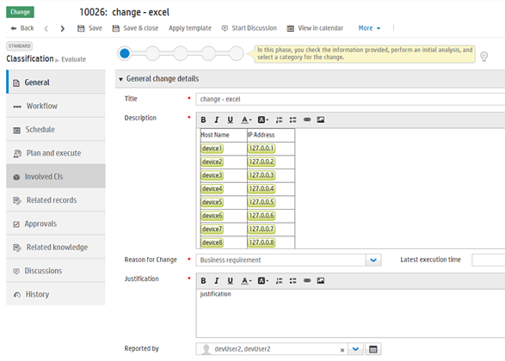
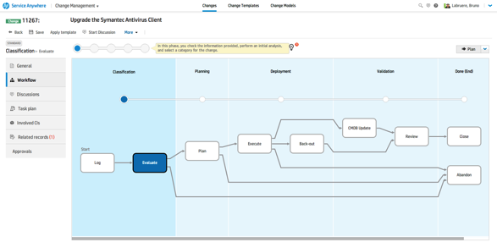
Change Management Overview
Governance - ITIL Aligned Workflows
Normal, Standard, and Emergency process flows
Approval plan(s) for each process flow
Promotes reuse and consistency
Change Model provides default task plans, default values, and user options
View and Edit the Task Plan on each RFC
Collaboration
Record conversations on a Change
Fast CI Detection
Quickly associate CIs with a change by typing or pasting CI names into the change description
Notes:
Change Management includes the activities necessary for you to control changes to service assets and configuration items across the entire service life cycle. It provides standard methods and procedures to use when implementing all changes.
Change Management module helps ensure that your organization:
Follows a predefined change process.
Notifies stakeholders at checkpoints in that process.
Monitors the progress of each change request.
Notifies stakeholders if deadlines are missed.
Tracks each change through the appropriate life cycle: simple or complex.
Adheres to ITIL V3 recommendations for standard, normal, and emergency change requests.

Slide 5
Change Management Workflow Overview
Each of the change workflows reflects ITILv3 process recommendations. These are:
Standard
This is a pre-approved change, of low risk. It is relatively common and follows a standard procedure or work instruction
Normal
This is a change that must follow the complete change management process. It proceeds through all steps of the change management process, and if successfully completed, is reviewed by a Change Advisory Board (CAB)
Emergency
This is an expedited process, which implements changes to the production environment when an emergency caused by a service outage occurs. This process proactively prevents a serious service outage
Notes:
Change Management workflow
Change management is responsible for the lifecycle of all changes. The aim is to respond to changing business requirements while maximizing value and reducing incidents, disruption, and rework. The process minimizes the impact of change-related incidents on service quality, and consequently, improves the day-to-day operations of the organization. This process includes activities that ensure the measurability of the impact of a change within the environment.
A workflow is the end-to-end process from the change creation to the change closure. The building blocks of the workflow are metaphases, phases, and transitions. Service Anywhere displays a graphic view of the workflow where you can see the current phase and the transitions that connect the current phase to all other phases.
The Change Management process workflow includes all necessary steps to log and implement a change, including any necessary back-out or abandonment. When you update a record or assign a new status, the record can transition from one phase to the next automatically.
Each of the Service Anywhere change workflows reflects ITILv3 process recommendations.

Slide 6
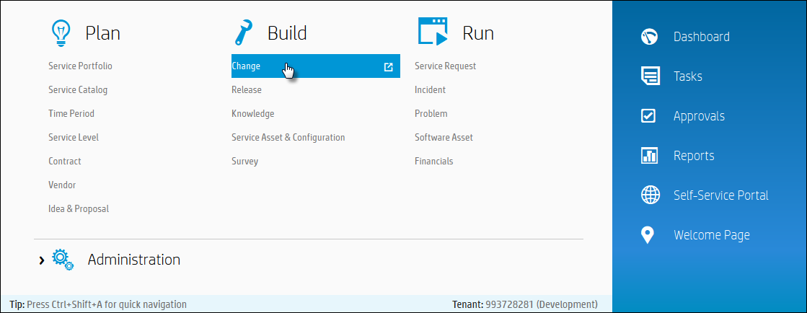
IT Agent Accessing Change Management
Mega Menu > Build > Change

Slide 7
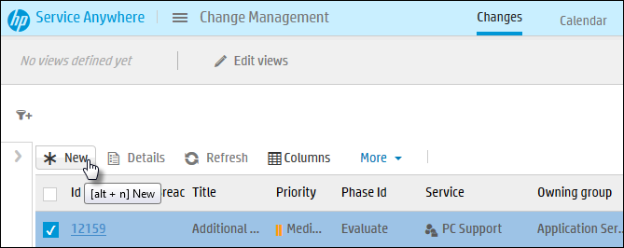
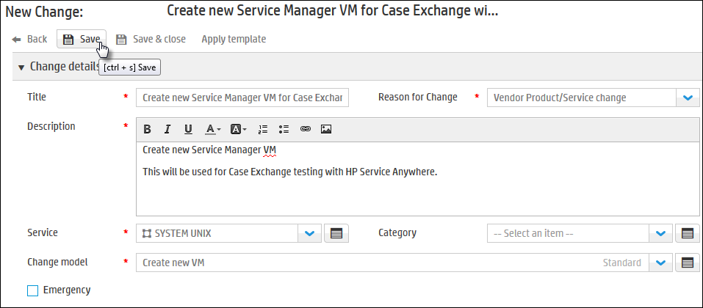
How to Open a New Change – Recap
A new change can be opened from Change List, from within an incident, problem or change
From Change List, click New button.
Change Model sets the category and other fields
In the New Change form, fill in details and click Save.

Slide 8
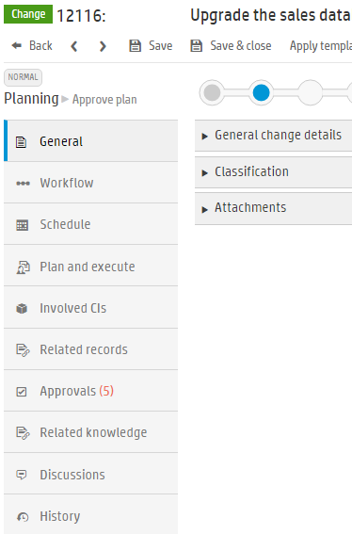
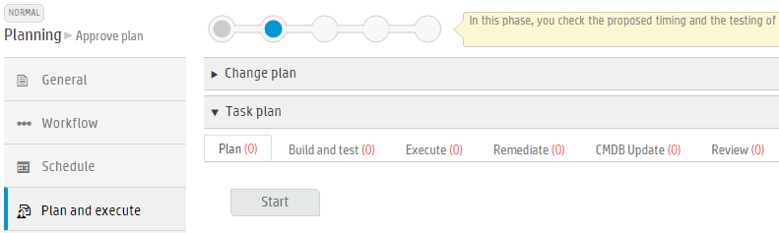
Change Management
Record content

Slide 9
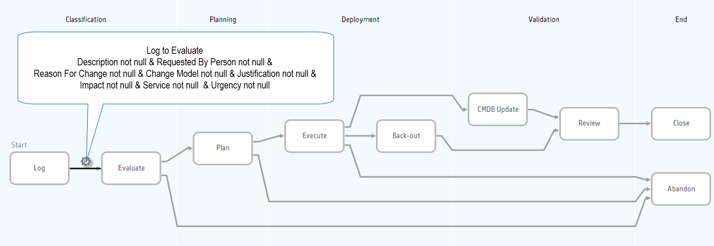
Standard Change Workflow

Slide 10
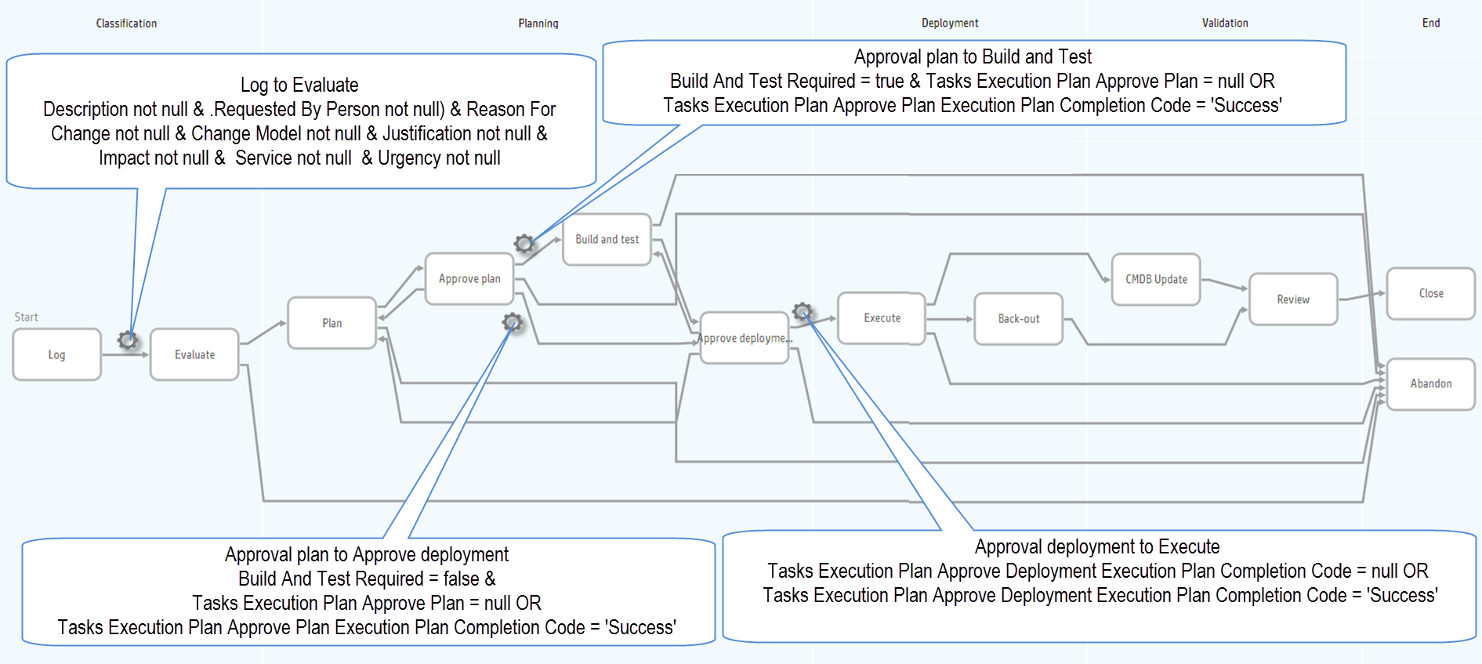
Normal Change Workflow – Automatic Forward Transitions

Slide 11
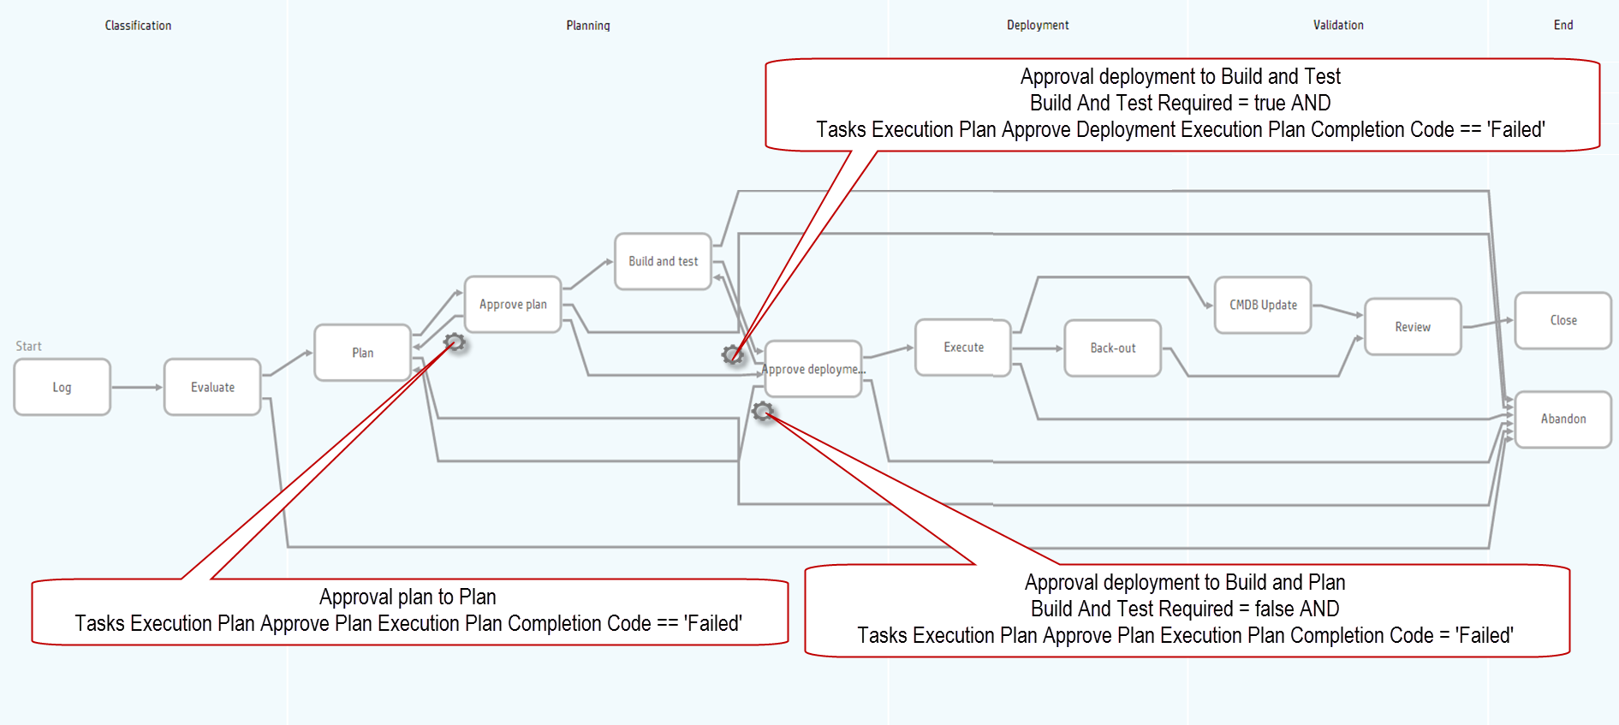
Normal Change Workflow – Automatic Reverse Transitions

Slide 12
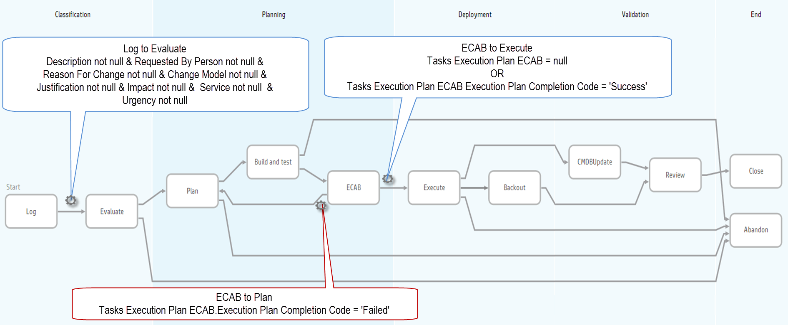
Emergency Change Workflow

Slide 13
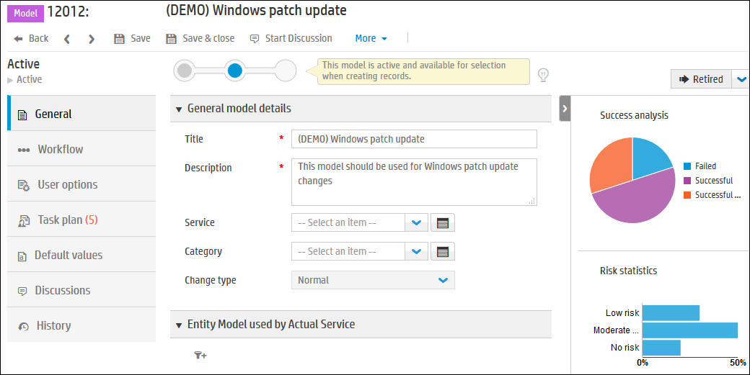
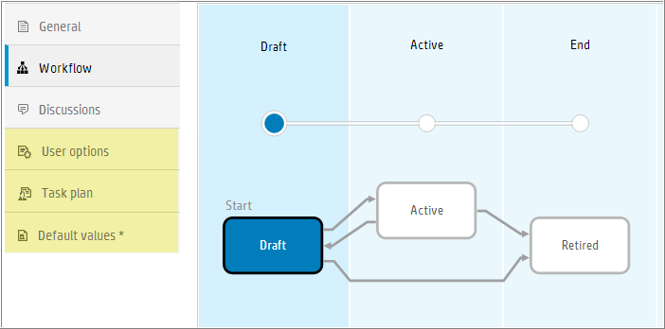
Change Models
Simplifies the change process
Create a new model or from an existing change
Defines Change type (workflow)
Define User options, Task plan, Default values
Draft status allows defining
Change type
Task Plans
Default values
Activation based on Model rights
Notes:
Change models
A model simplifies the creation of a record. For example, when you have common change requests, it is efficient to design a model that you can reuse to simplify the amount of effort required to request that same type of change many times. Models standardize the end-to-end process and maximize efficiency.
Example: a Service Anywhere model pre-populates common fields to save time when you create a new record. When you create a new change and select an appropriate change model, Service Anywhere automatically populates the relevant fields and creates the tasks necessary to complete the change.
Service Anywhere provides a set of default models, and you can add models as required. If you no longer require a model, you delete it.
Note: when you add a new model, Service Anywhere automatically creates the workflow and displays the model in draft status.
Click the model's workflow tab to see the workflow and status.
The following may only be edited when the model is in draft status:
Change type
Task plans
Default values
To change the status to active, you must have the appropriate rights. For more information about model status, see How to activate a change model.
How to activate a change model
Note: You must have the appropriate permissions to be able to activate a change model.
To activate a change model means changing its status, as shown in the workflow snapshot at the top of the model, from draft to active.
From the main menu, click Change Management > Change Models.
Select the change model.
Click the record identifier in the ID column to display the selected record.
Click Active, then Save.

Slide 14
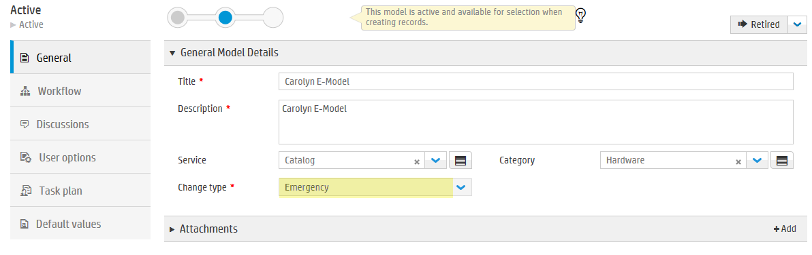
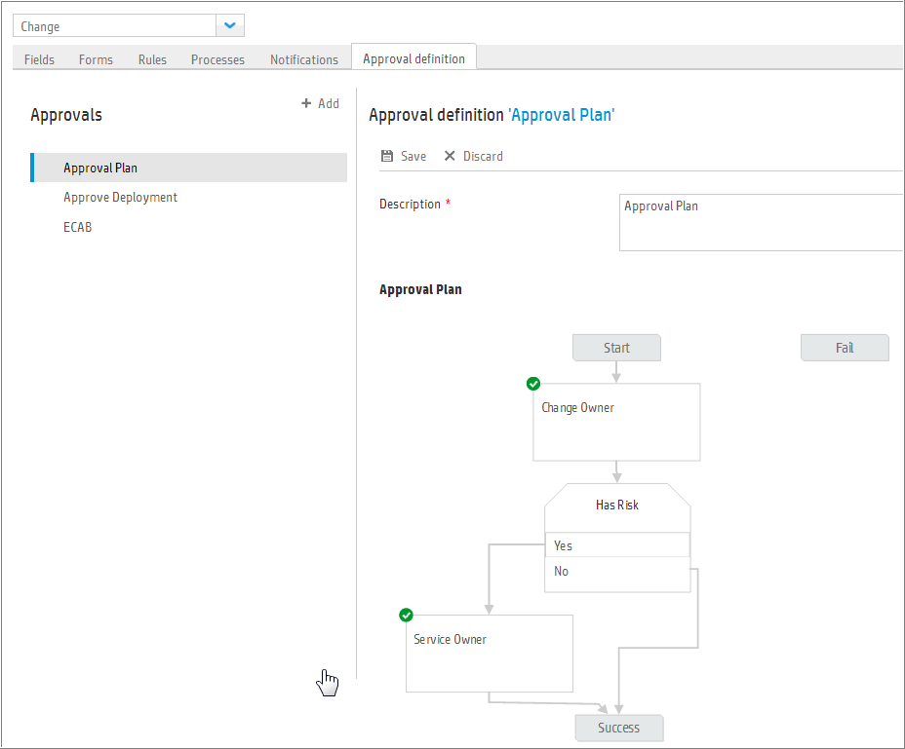
Approvals
Defined at the Record level
Applied to:
Normal Changes
Approve Plan
Approve Deployment
Emergency Changes
ECAB Approval
When opening a Change, the Change model is required. Business rules and Model determine the approval plan

Slide 15
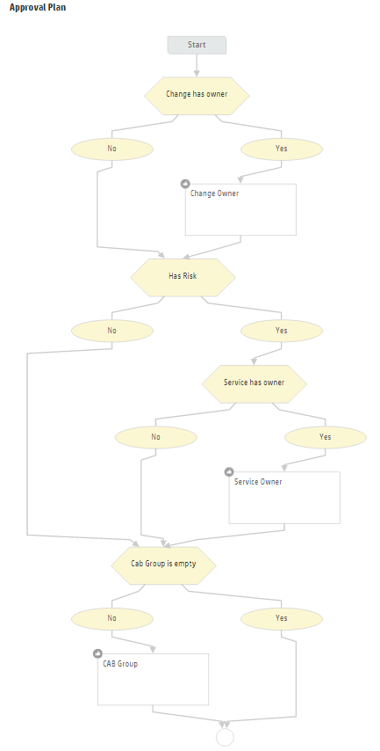
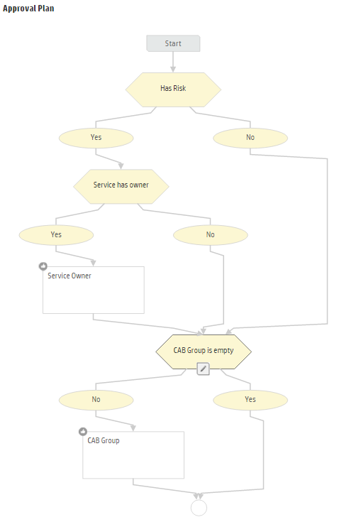
Approvals for Normal Change
Normal Change has 2 approval phases
Normal Change – Approve Deployment
Normal Change – Approve Plan
Notes:
Administration > Records → Change → Approval definitions → Normal Change – Approve Plan
Administration > Records → Change → Approval definitions → Normal Change – Approve Deployment

Slide 16
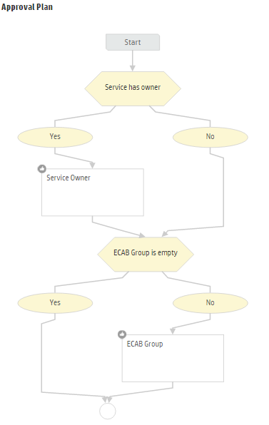
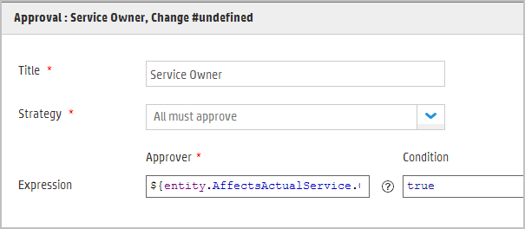
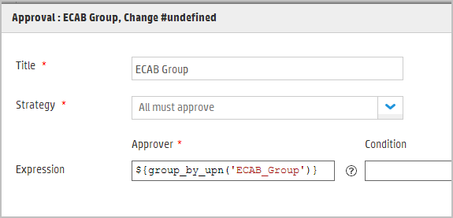
Approvals for Emergency Change
Administration > Records → Change → Approval definitions → Emergency Change - ECAB
Emergency Change has 1 approval phase
Is there a Service owner?
Yes, schedule Service Owner approvals
No, check for ECAB approval
Is the ECAB Group empty?
Yes, end
No, schedule ECAB approval
Emergency Change – ECAB'
Notes:
Administration > Records → Change → Approval definitions → Emergency Change - ECAB

Slide 17
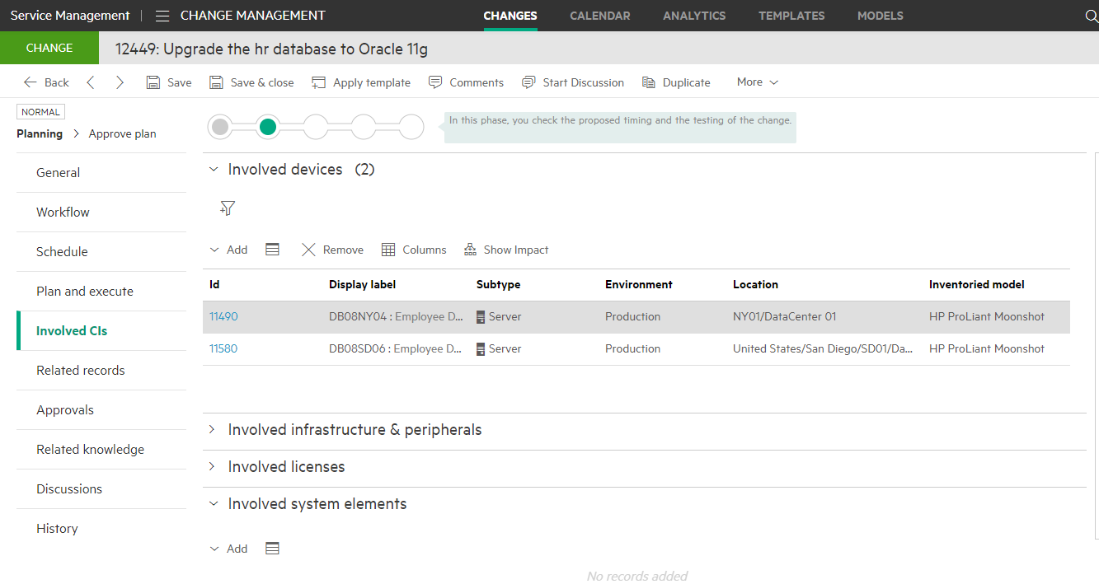
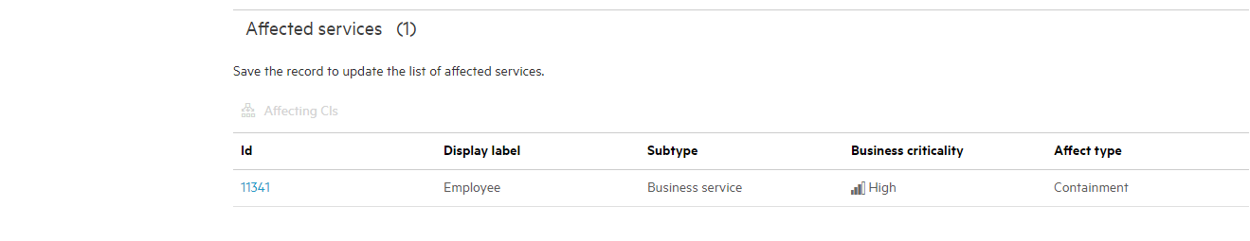
Change and SACM
Involved Cis and SACM model
General tab Classification
Actual service (Referenced)
Service Component
Involved CIs tab
Devices
Involved Infrastructure & peripherals
Involved Licenses
System elements
Affected Services (unique to Change record type)
Affecting CIs (unique to Change record type)

Slide 18
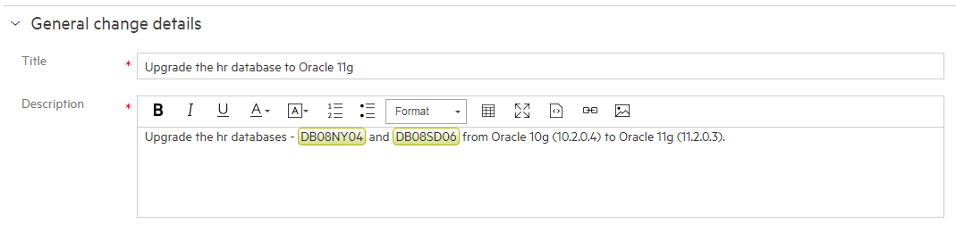
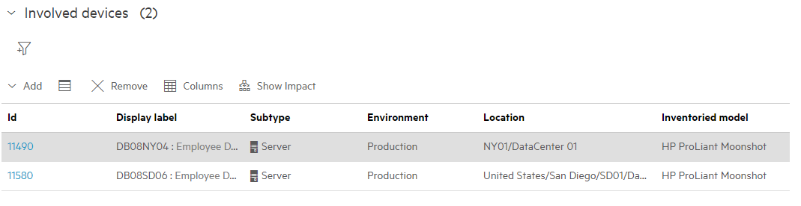
CI Detection
Type or copy and paste CI into Description and it will be added to Involved CIs
Automatic detection
Analyze content of request/incident description and incident solution
Automatic highlight of asset/Cis in the text
Seamless linking of CI to the ticket
Importance of linking impacted CIs
This helps increase the quality of the ticket, speeding resolution and reducing ticket volume
Helps reduce creation of duplicate tickets for the same asset
Notes:
Quickly associate CIs with a change by typing/pasting CI descriptions into the Change Description field.

Slide 19
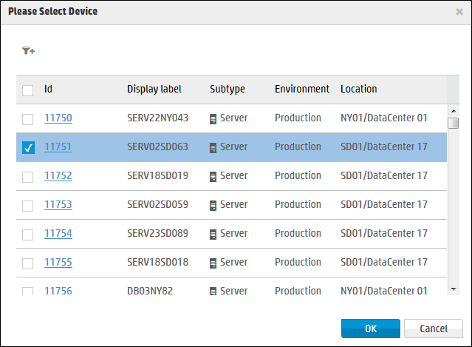
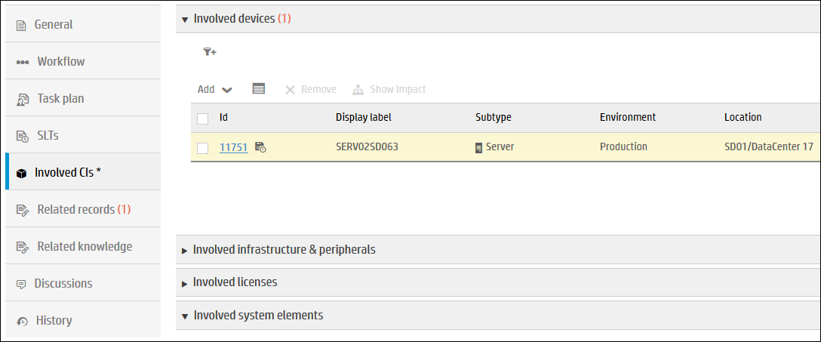
Involved CIs – manual add

Slide 20
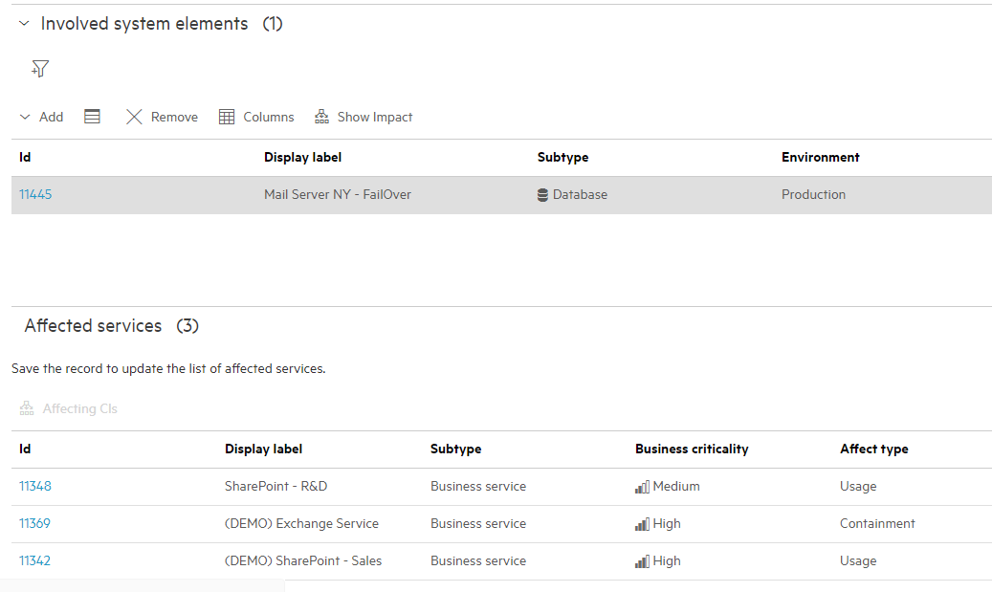
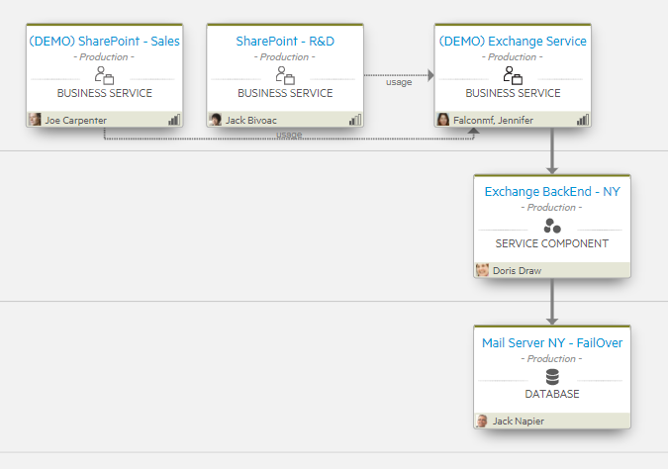
Impact visualization
Bottom-up view from Involved CI
“Show Impact” button provides impact visualization from a given CI in the Involved CI list (Incident, Problem, Change)
Notes:
To access, navigate to a Change. In the “Involved Cis” tab, add an Involved Device , select it, and press the “Show Impact” button.

Slide 21
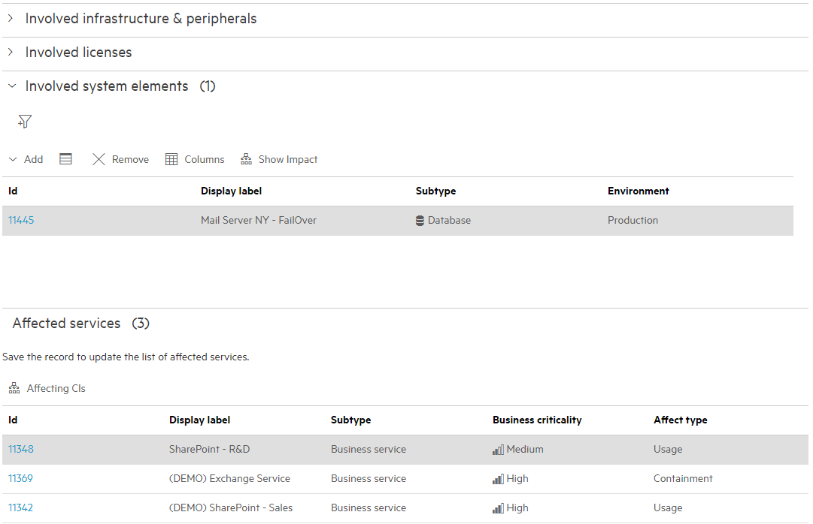
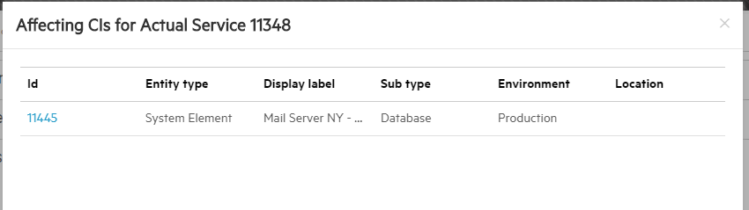
Impact visualization
Top-down from Affected Service
Select an Affected Service and view “Affecting CI” for a given service
Notes:
To access, navigate to a Change. In the “Involved Cis” tab, go to the list of Affected Services and select a row for a Service (not the link to the service), select it, and press the “Affecting CIs” button.

Slide 22
Release Management Overview

Slide 23
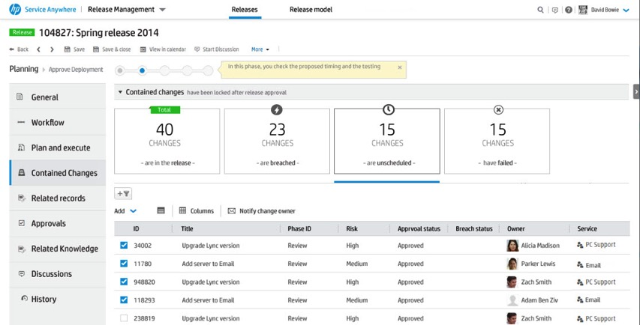
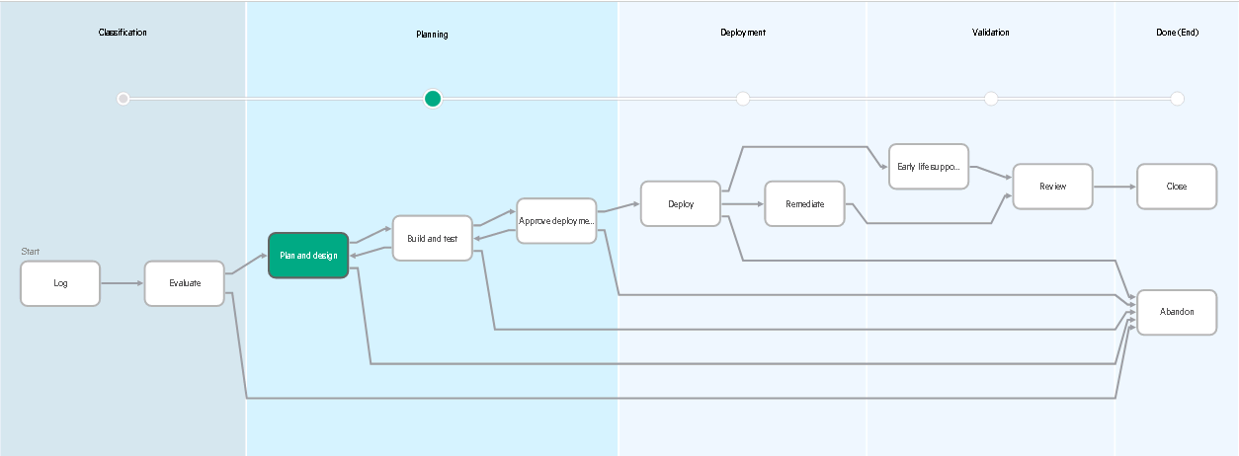
Release Management Overview
Operationalize your application releases
Release lifecycle
Manage the planning and deployment of the release and its components
Manage Changes within a Release
Track included change status
Schedule changes within a release
Release level reporting – with actionable tiles that drill into changes under different release statuses

Slide 24
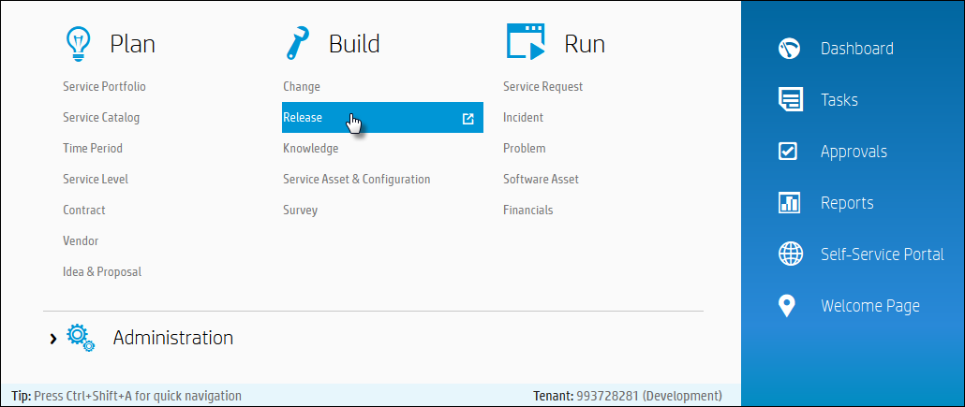
IT Agent Accessing Release Management
Mega Menu > Build > Release

Slide 25
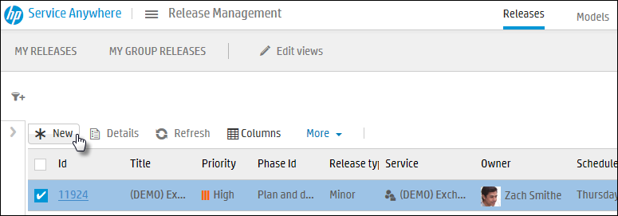
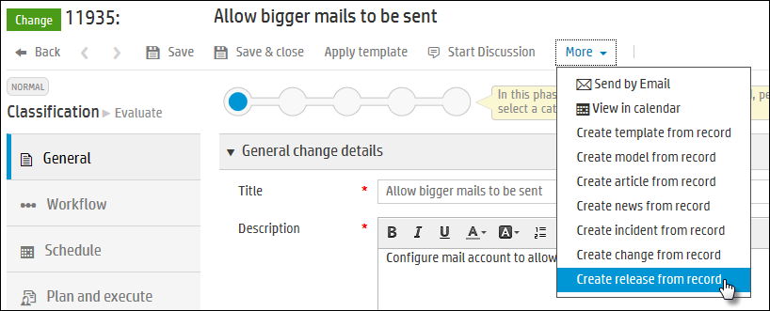
How to Open a New Release
A new release can be opened from Release List or from within a change
From Release List, click New button.
In the Change, go to More > Create release from record.

Slide 26
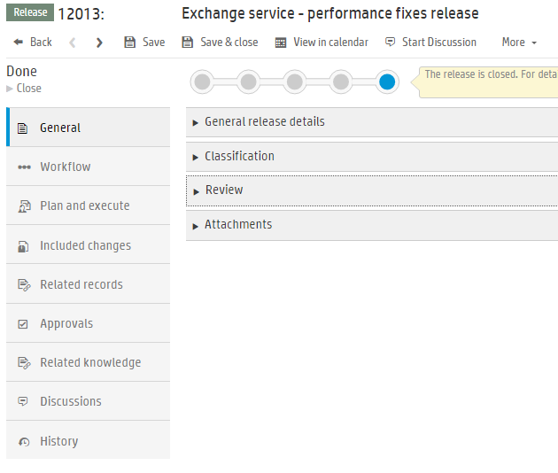
Release Management
Record content

Slide 27
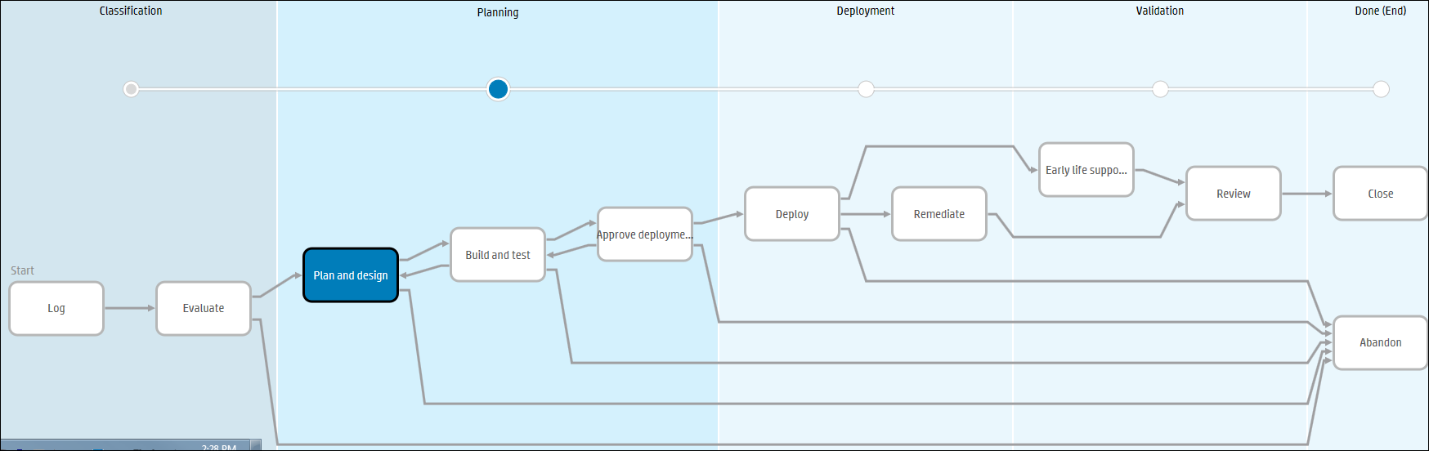
Release Workflow
A release has its own approval phase which is independent to the change approvals

Slide 28
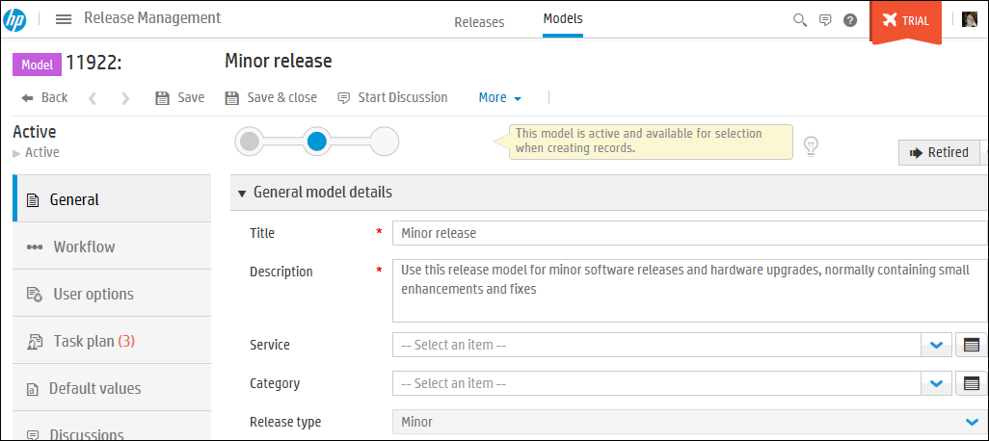
Release Models
Mega Menu > Build > Release > Models
A release model simplifies the creation of a release record.
It pre-populates common fields to save time and standardize input.
A model can contain a Task Plan, so it will create tasks to complete the release.
Analytics are not provided for Release Models.

Slide 29
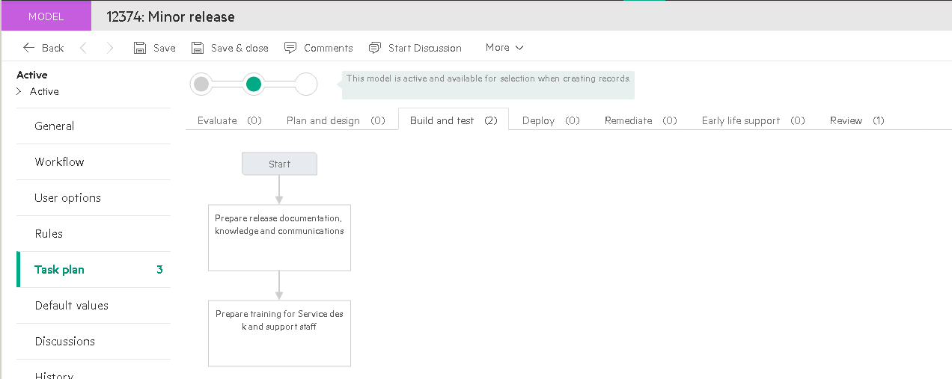
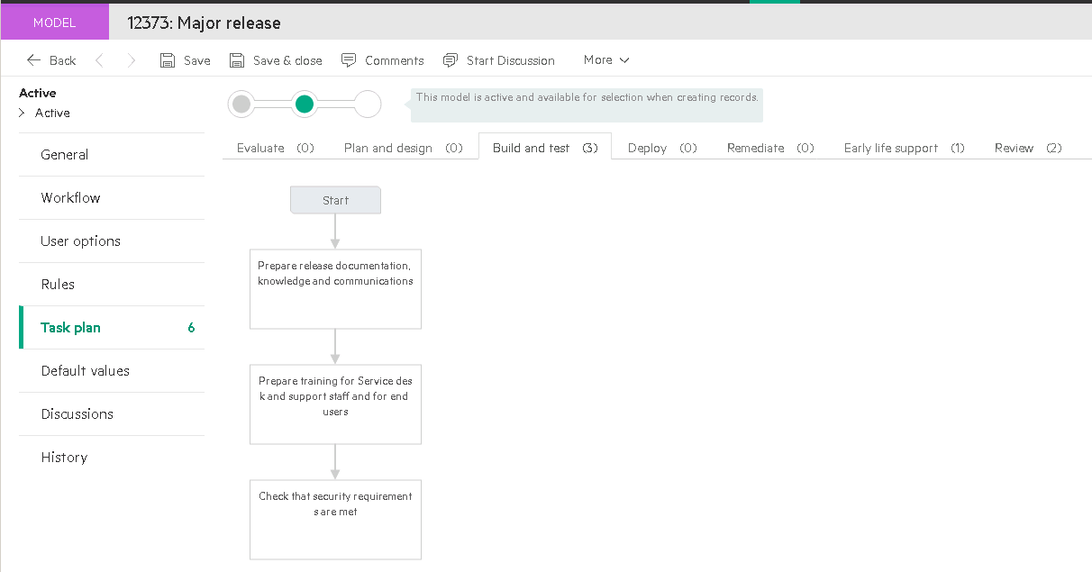
Release Models
Minor and Major Releases

Slide 30
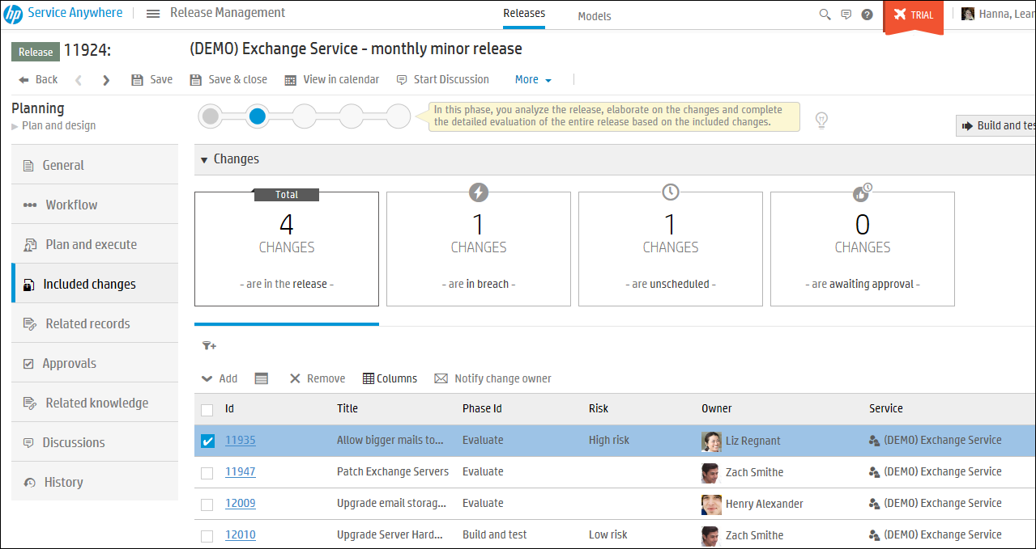
Release Management – Included Changes
Pre-defined filter tiles give information on included changes managed in release.
Changes not scheduled appropriately
Changes not scheduled
Changes awaiting approval
Changes managed by this release
Changes managed by this release
Email Change owners
Blue line shows which tile is being used for filtered list
Notes:
This is one of the most important aspects of release mgmt. Understanding for this release, what are the changes that I am going to be managing through the process – so this group of changes being deployed into prod together. So manage the release and its included changes.
Can quickly see where the changes are in their own lifecycle.

Slide 31
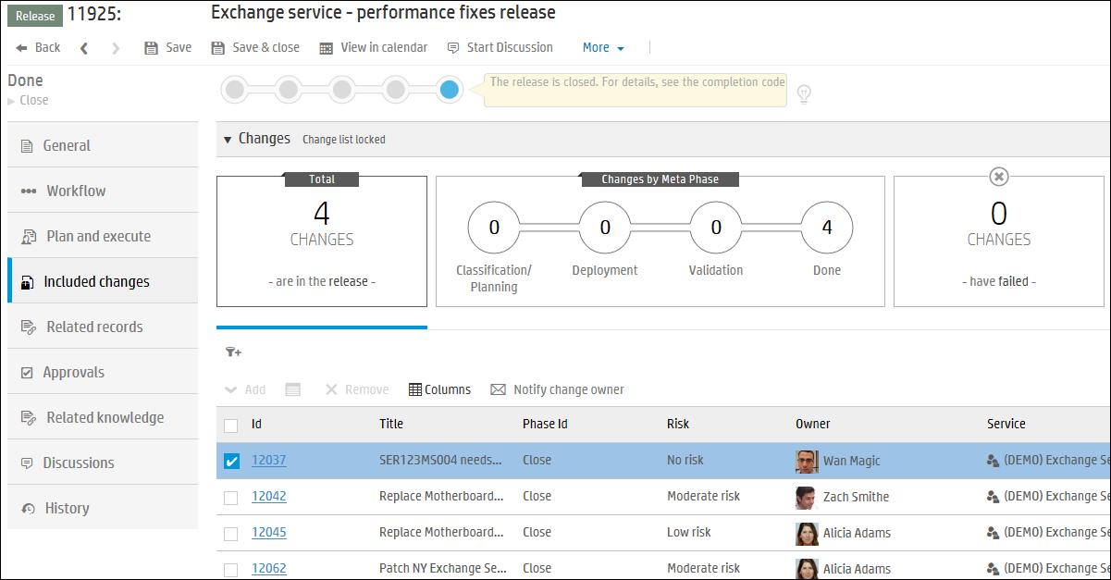
Release Management – Included Changes
Pre-defined filter tiles change depending upon lifecycle of release.
Once a release moves to Deployment, the filter tiles change to show deployment information
Quick view of how changes are progressing
Changes managed by this release
Changes which have failed

Slide 32
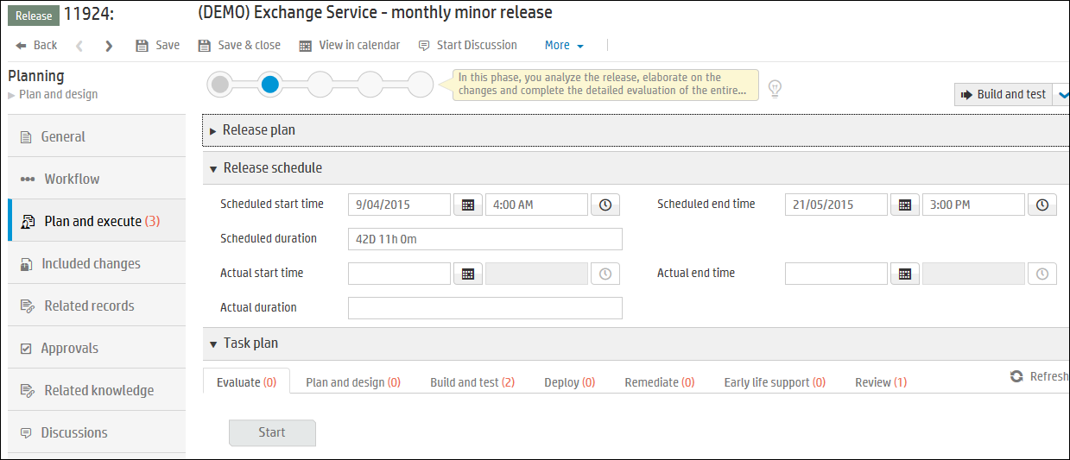
Release Management – Release Plan
Plan the release, set up the release schedule and task plan.
Tasks are activities to carry out for this release, not specific to any of the included changes

Slide 33
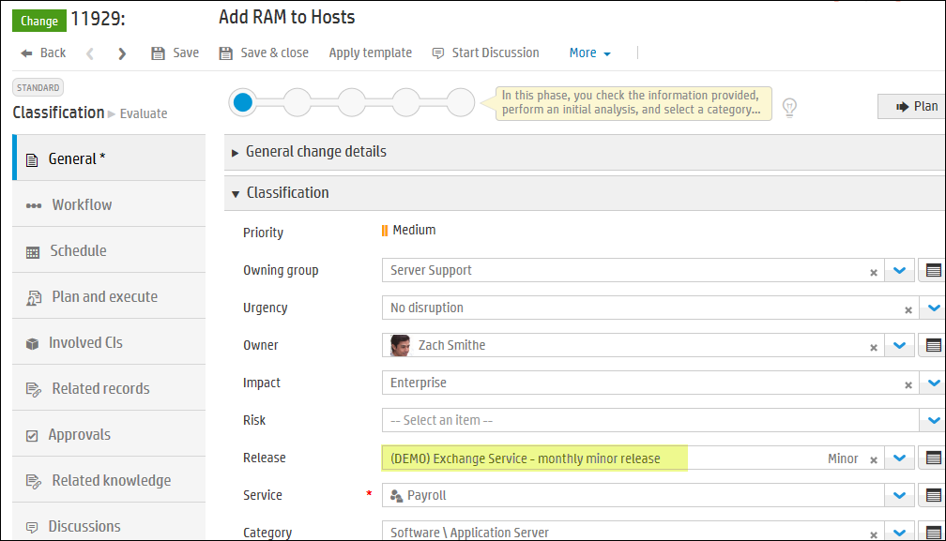
Adding changes to a Release
Use “Add” button on Included Changes tab of a Release record or
From within a change, you can specify a release which includes this change in the release.

Slide 34
Change Calendar

Slide 35
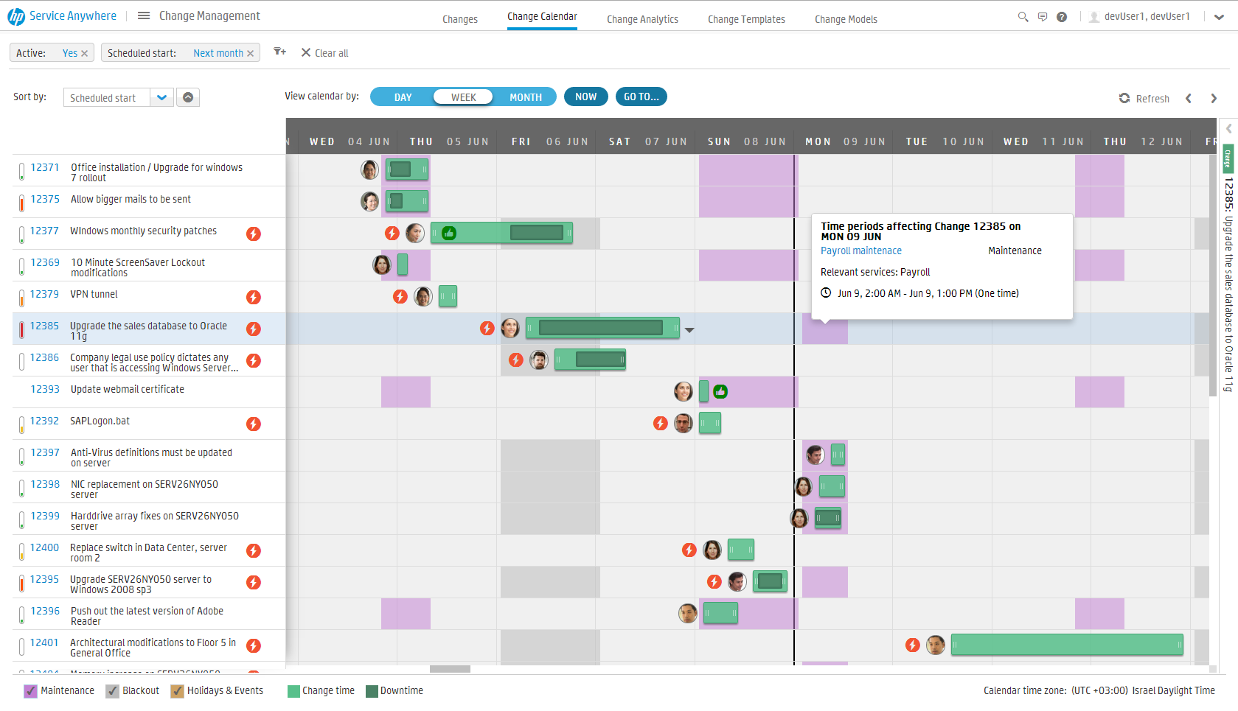
Change Calendar Features
Visualize changes in the Forward Schedule of Changes
Visualize scheduled maintenance windows and flag changes that fall outside planned maintenance
Track planned and ongoing change status
Identify collisions with Black Out Periods
Drag and drop change on the calendar view to reschedule
Manage a change schedule directly within a change
Notes:
The Change Calendar displays changes and time periods and allows you to view, schedule and manage changes in a Gantt chart.
To access, navigate to the Change Management, and click on the Change Calendar sub-menu tab.

Slide 36
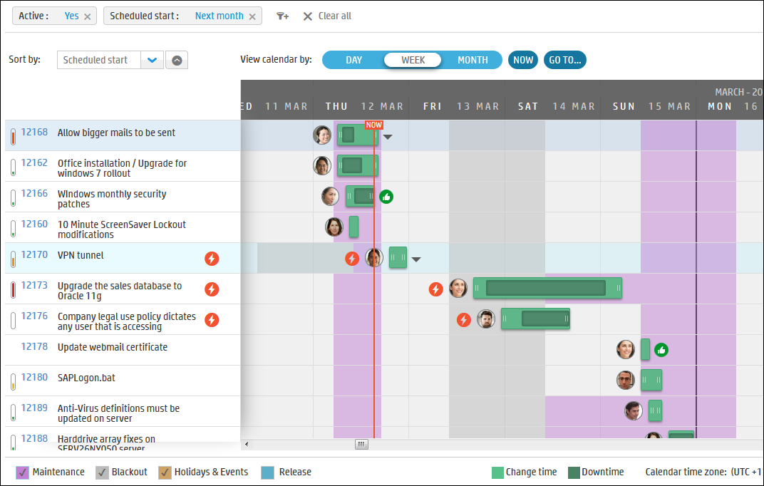
Change Calendar
Filter for changes in calendar
Calendar view
How to sort change list
Risk indicator
Blackout window
Approved
Outside Maintenance or in Blackout window
Maintenance window

Slide 37
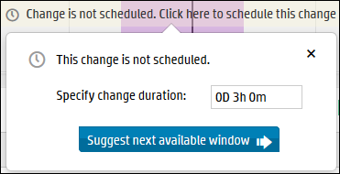
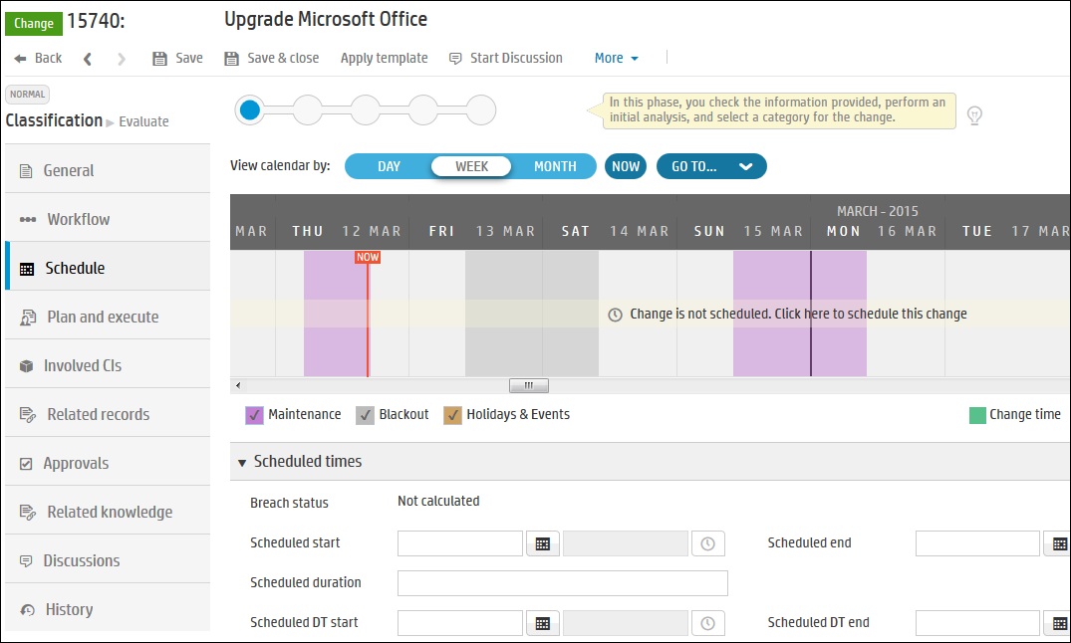
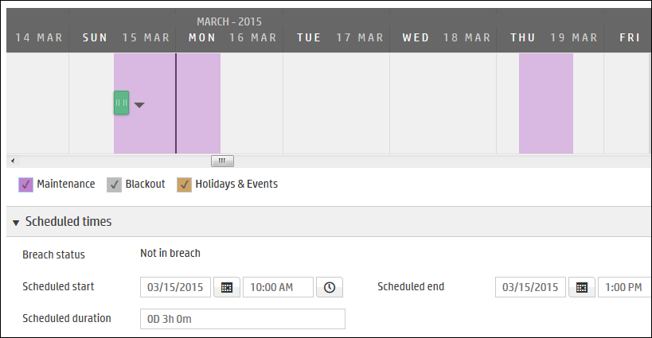
Change Calendar
Within a change record’s Schedule tab, you can schedule the change.
Next available window suggestions are offered.

Slide 38
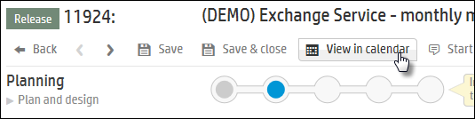

Release Management – Release View in Calendar
Once the release is scheduled, you can view the changes in the Change Calendar in the context of the release in Release View
Shows the includes changes within the release
You can schedule the changes for the release in the calendar
Notes:
Releases and the Change Calendar
You can view a release in the Change Calendar as follows:
From Release Management:
Select the release record you want to view.
In the release, click the View in calendar button.
To view another release, click the View other release button and select the release to view.
From the Change Calendar:
Go to the Change Calendar.
Click the View release button on the top right hand side of the calendar.
Select the release you want to view and the Change Calendar will be displayed in release mode.
To view another release, click the View other release button and select the release to view.

Slide 39

Release Management – View in Calendar
Release being displayed
Type of release and schedule
Show other releases
Hover over blue line to show planned release time
Change scheduled outside maintenance window
Notes:
Releases and the Change Calendar
You can view a release in the Change Calendar as follows:
From Release Management:
Select the release record you want to view.
In the release, click the View in calendar button.
To view another release, click the View other release button and select the release to view.
From the Change Calendar:
Go to the Change Calendar.
Click the View release button on the top right hand side of the calendar.
Select the release you want to view and the Change Calendar will be displayed in release mode.
To view another release, click the View other release button and select the release to view.

Slide 40


Time Period Management
Change Management
Event Types
Maintenance
Blackout
Holiday
Event
Time Periods

Slide 41
Approvals

Slide 42
Task Plan and Approvals for Change and Release - Recap
Approvals are set at the Record level for Changes and Releases
Conditions can be used to build complex approval plans
Strong identity validation (2 factor authentication) is supported
Approvals applied to these phases:
Normal Changes
Approve Plan
Approve Deployment
Emergency Changes
ECAB Approval
Releases
Approve Deployment

Slide 43

Security Codes for Strong identity verification
Passcode
Used for encrypted fields and strong identity verification
generated by the user
10 to 20 characters long containing at least one upper case character, at least one lower case character, and at least one number.
Profile & Preferences > Security Settings
Passcode Verification Code
Used once to verify user after they create a passcode (and then must request a verification code)
generated by manager of user, or tenant admin, or role with permission to “Manage passcode verifications”
Profile & Preferences > Manage passcode verifications
Authorization Code
Used for Strong Identity validation (two factor verification)
Generated by the system and emailed to the user at validation or approval time
Encryption Domain Verification code (not related to Strong Identity Validation)
Used for encrypted field
Generated by user with role having Encryption domain administrator permission
Admin > People > Encryption Domains

Slide 44



Generating Passcode verification codes
To assign verification codes for users, you must have one of the following permissions:
the Tenant Admin role
the permission to generate verification codes in the System use definitions section of the User page
A manager can generate verification codes for their employees only
In either case, your passcode must be verified

Slide 45




Strong Identity Validation in ESS
Require a second pin-based code for secure actions such as certain approvals or record updates
Service Management
Note: passcode and authorization code boxes require you
to press the buttons, you can’t press enter.

Slide 46




Strong Identity Validation in agent interface
Require a second pin-based code for secure actions such as certain approvals or record updates
Service Management
Note: passcode and authorization code boxes
require you to press the buttons, you can’t press enter.

Slide 47


Demo system configuration for Strong Identity Validation
Application Settings:
Strong Identity Validation is enabled
Allow tenant admin to bypass Strong Identity Verification is enabled
The demo tenant is configured to require Strong Identity Verification for the ECAB group to approve a “Very High” Risk Emergency change.
Admin>Records>Task>Authorization:
Choose “Enabled for records based on condition”
Condition:
${entity.ParentEntityType == 'Change' && entity.AssignmentGroup.Name == 'ECAB Group' && entity.RiskAssessment == 'VeryHighRisk'}
Note: Multiple conditions are supported.
Validation will apply to records matching any of the conditions.

Slide 48
Change Analytics

Slide 49




Change Analytics Features
KPIs and Process improvement suggestions
Change Analytics
Improve your change management practice by tracking Success rate, use of Standard change, and Change automation
Understand your improvement over time with KPI trend by week or by month
Define goals to help drive organization change
Automate smartly – the Change automation KPI suggests most popular models to target for automation
View the Success analysis, risk statistic, best 3 and worst 3 changes for similar changes
Time Period Breach Driven Process
Utilize the time period breach information to drive approvals and business rules
Notes:
Change Analytics applies big data techniques to changes, providing suggestions and action items to improve KPIs and process. The new trend chart provides a historical view over time, making it easier to understand trends
Immersive analytics are also found on the Change record itself, helping agents to make fact-based decisions. Now, recent successes and failures are at the agents finger tips, to help direct the action required on the new change
Similar change = same model, same service

Slide 50

Analytics & Continuous Improvements - panels
Services Bar
Filter Panel
Success Rate Panel
Line chart showing success rate trends in last 6 months
Insights Panel
Action Point Panel

Slide 51

Change Analytics – Success Rate Panel
Improve Change Management Practice
Percentage of Successful changes (All, Standard, Normal, Emergency)
Percentage of Standard changes
Percentage of Changes using Automated tasks (All, Standard, Normal)

Slide 52


Improve Change Management Practice
Define goals to help drive organization change

Slide 53


Improve Change Management Practice
View suggested action points

Slide 54


Improve Change Management Practice
View the Success analysis and risk statistic for similar changes and change models
Go to model(s) to look for improvements
Note: Insights and suggested action points only display when the number of successful and unsuccessful changes within your selection exceeds a minimum threshold.

Slide 55


Lab Exercises
Change Mgmt Quick Flow Demo card with optional strong identity validation option
Release Mgmt Quick Flow Demo card

